Slide 1
POWERBASE BEGINNERS
Review units 1-4

Slide 6
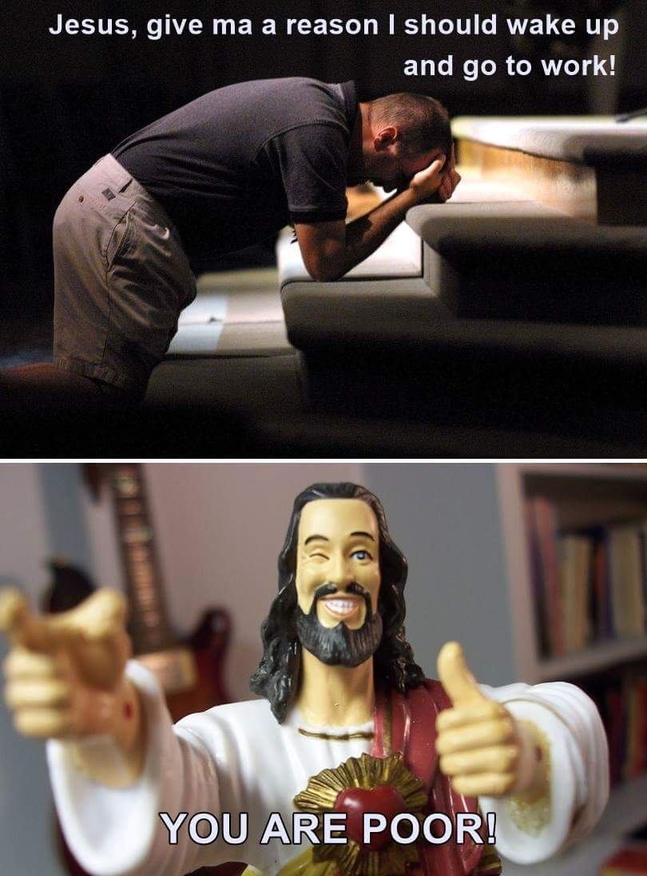

Slide 7
Do you remember?

Slide 9
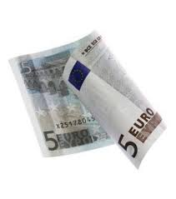
How much is it?

Slide 10
Can I help you?

Slide 11
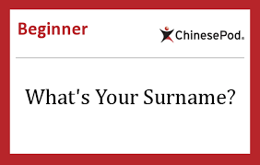

Slide 12
How do you spell

Slide 13
How do you spell

Slide 14
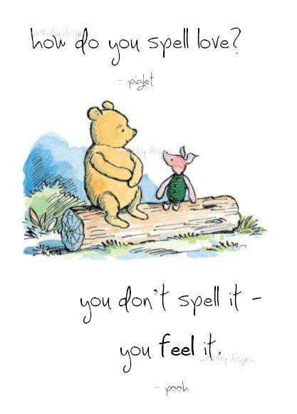

Slide 17
What’s this?

Slide 21
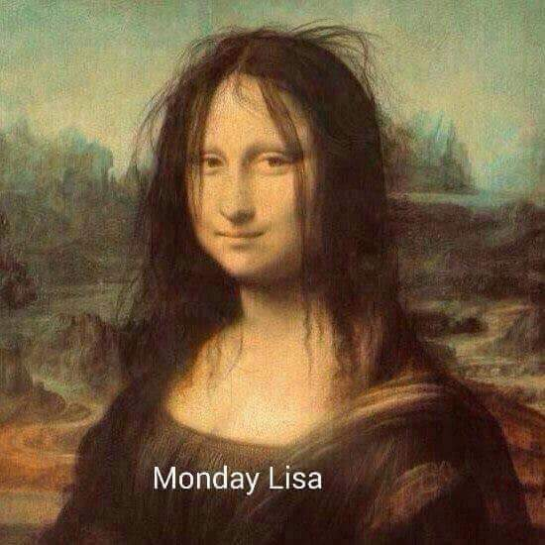

Slide 22
How do you say that in English?

Slide 23
How do you say that in English?

Slide 24
How do you say that in English?

Slide 25
How do you say that in English?

Slide 29
Can I ___________ to Tom, please?

Slide 30
What’s _____ name?

Slide 31
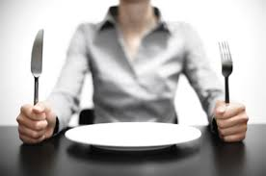
Are you _____ ?

Slide 32
_____ we meet tomorrow?

Slide 33
Can you ___________ again, please?

Slide 34
_____ a taxi, please?

Slide 35
